Slide 1
Basic I/O

Slide 2
Java I/O (Input and Output) is used to process the input and produce the output.
Java uses the concept of a stream to make I/O operation fast. The java.io package contains all the classes required for input and output operations.
Stream
A stream is a sequence of data. In Java, a stream is composed of bytes. It's called a stream because it is like a stream of water that continues to flow.
In Java, 3 streams are created for us automatically. All these streams are attached with the console.
1) System.out: standard output stream. Ex:System.out.println("simple message");
2) System.in: standard input stream. Ex: int i=System.in.read(); System.out.println((char)i);
3) System.err: standard error stream. Ex: System.err.println("error message");

Slide 3
1. OutputStream vs InputStream
OutputStream-Java application uses an output stream to write data to a destination; it may be a file, an array, peripheral device or socket.
InputStream-Java application uses an input stream to read data from a source; it may be a file, an array, peripheral device or socket.

Slide 4
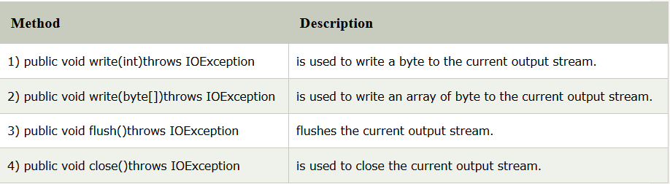
OutputStream class: OutputStream class is an abstract class. It is the superclass of all classes representing an output stream of bytes. An output stream accepts output bytes and sends them to some sink.

Slide 5
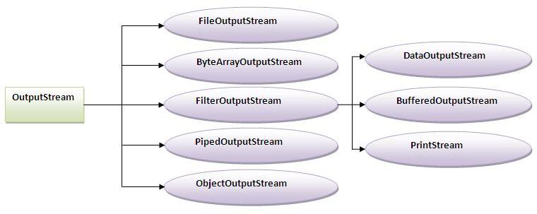

Slide 6
InputStream class: InputStream class is an abstract class. It is the superclass of all classes representing an input stream of bytes.
Method | Description
1) public abstract int read()throws IOException: | reads the next byte of data from the input stream. It returns -1 at the end of file.
2) public int available()throws IOException: | returns an estimate of the number of bytes that can be read from the current input stream.
3) public void close()throws IOException: | is used to close the current input stream.

Slide 7
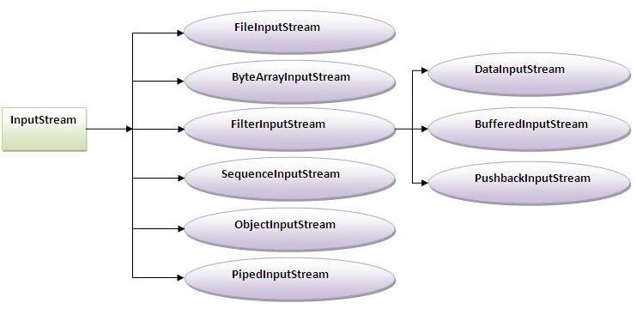

Slide 8
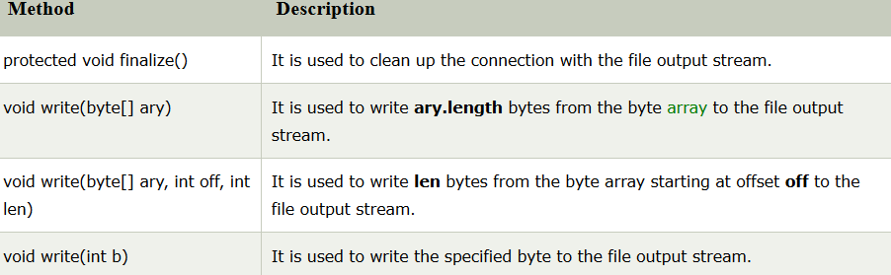
2.Java FileOutputStream Class
The declaration: public class FileOutputStream extends OutputStream .

Slide 9
Java FileOutputStream Example 1: write byte
import java.io.FileOutputStream;
public class FileOutputStreamExample {
public static void main(String args[]){
try{
FileOutputStream fout=new FileOutputStream("D:\\testout.txt");
fout.write(65);
fout.close();
System.out.println("success...");
}catch(Exception e){System.out.println(e);}
}
}

Slide 10
java FileOutputStream example 2: write string
import java.io.FileOutputStream;
public class FileOutputStreamExample {
public static void main(String args[]){
try{
FileOutputStream fout=new FileOutputStream("D:\\testout.txt");
String s="Welcome to javaTpoint.";
byte b[]=s.getBytes();//converting string into byte array
fout.write(b);
fout.close();
System.out.println("success...");
}catch(Exception e){System.out.println(e);}
}
}

Slide 11
Java FileInputStream Class:
Java FileInputStream class obtains input bytes from a file. It is used for reading byte-oriented data (streams of raw bytes) such as image data, audio, video etc.
Declaration: public class FileInputStream extends InputStream

Slide 12
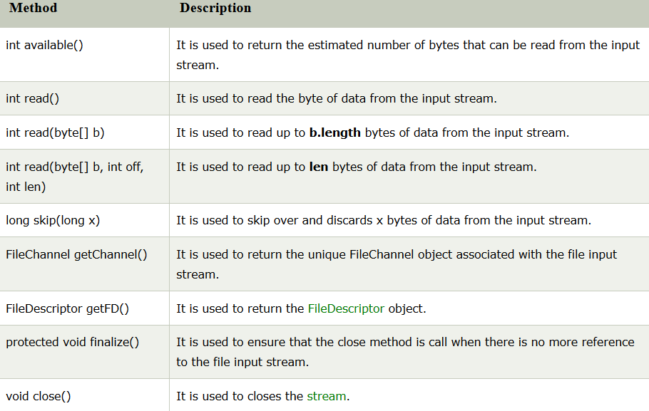

Slide 13
Java FileInputStream example 1: read single character
import java.io.FileInputStream;
public class DataStreamExample {
public static void main(String args[]){
try{
FileInputStream fin=new FileInputStream("D:\\testout.txt"); int i=fin.read();
System.out.print((char)i);
fin.close();
}catch(Exception e){System.out.println(e);}
}
}
After executing the above program,
you will get a single character from the file which is 87 (in byte form).
To see the text, you need to convert it into character.

Slide 14
Java FileInputStream example 2: read all characters
import java.io.FileInputStream;
public class DataStreamExample {
public static void main(String args[]){
try{
FileInputStream fin=new FileInputStream("D:\\testout.txt");
int i=0;
while((i=fin.read())!=-1){
System.out.print((char)i);
}
fin.close();
}catch(Exception e){System.out.println(e);}
}
}

Slide 15
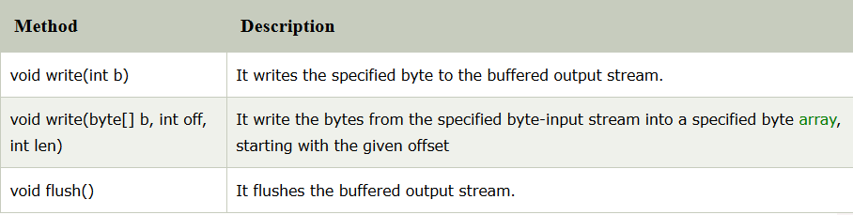
3. Java BufferedOutputStream Class
Java BufferedOutputStream class is used for buffering an output stream.
It internally uses buffer to store data.
It adds more efficiency than to write data directly into a stream. So, it makes the performance fast.
Syntax:
OutputStream os= new BufferedOutputStream(new FileOutputStream("D:\\IO Package\\testout.txt"));

Slide 16
Example of BufferedOutputStream class:
import java.io.*;
public class BufferedOutputStreamExample{
public static void main(String args[])throws Exception{
FileOutputStream fout=new FileOutputStream("D:\\testout.txt");
BufferedOutputStream bout=new BufferedOutputStream(fout);
String s="Welcome to javaTpoint.";
byte b[]=s.getBytes();
bout.write(b);
bout.flush();
bout.close();
fout.close();
System.out.println("success");
}}

Slide 17
Java BufferedInputStream Class
Java BufferedInputStream class is used to read information from stream. It internally uses buffer mechanism to make the performance fast.
The important points about BufferedInputStream are:
When the bytes from the stream are skipped or read, the internal buffer automatically refilled from the contained input stream, many bytes at a time.
When a BufferedInputStream is created, an internal buffer array is created.

Slide 18
Example of Java BufferedInputStream
import java.io.*;
public class BufferedInputStreamExample{
public static void main(String args[]){
try{
FileInputStream fin=new FileInputStream("D:\\testout.txt");
BufferedInputStream bin=new BufferedInputStream(fin);
int i;
while((i=bin.read())!=-1){
System.out.print((char)i);
}
bin.close();
fin.close();}
catch(Exception e){System.out.println(e);}
}
}
Here, we are assuming that you have following data in "testout.txt" file:
javaTpoint
Output:
javaTpoint

Slide 19
4. Java Reader
Reader is an abstract class for reading character streams.
The only methods that a subclass must implement are read(char[], int, int) and close().
Most subclasses, however, will override some of the methods to provide higher efficiency, additional functionality, or both.
Some of the implementation class are
Buffered Reader, CharArrayReader, FilterReader, InputStreamReader, PipedReader, StringReader

Slide 20
import java.io.*;
public class ReaderExample {
public static void main(String[] args) {
try {
Reader reader = new FileReader("file.txt");
int data = reader.read();
while (data != -1) {
System.out.print((char) data);
data = reader.read();
}
reader.close();
} catch (Exception ex) {
System.out.println(ex.getMessage());
}
}
}
file.txt:
I love my country
Output:
I love my country

Slide 21
Java Writer
It is an abstract class for writing to character streams.
The methods that a subclass must implement are write(char[], int, int), flush(), and close().
Most subclasses will override some of the methods defined here to provide higher efficiency, functionality or both.

Slide 22
import java.io.*;
public class WriterExample {
public static void main(String[] args) {
try {
Writer w = new FileWriter("output.txt");
String content = "I love my country";
w.write(content);
w.close();
System.out.println("Done");
} catch (IOException e) {
e.printStackTrace();
} } }
Output:
Done
output.txt:
I love my country

Slide 23
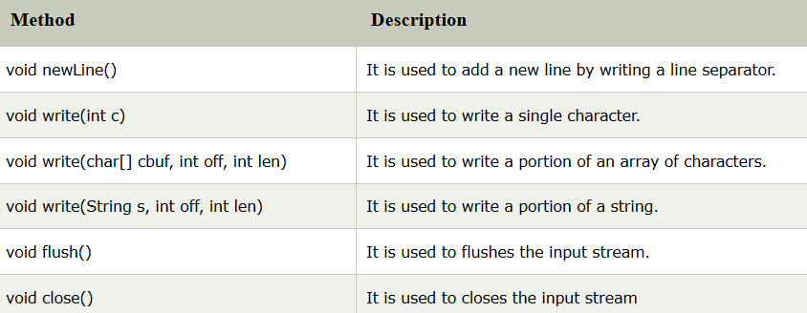
5. Java BufferedWriter Class Java BufferedWriter class is used to provide buffering for Writer instances

Slide 24
package com.javatpoint;
import java.io.*;
public class BufferedWriterExample {
public static void main(String[] args) throws Exception {
FileWriter writer = new FileWriter("D:\\testout.txt");
BufferedWriter buffer = new BufferedWriter(writer);
buffer.write("Welcome to javaTpoint.");
buffer.close();
System.out.println("Success");
}
}
Output:
success
testout.txt:
Welcome to javaTpoint.

Slide 25
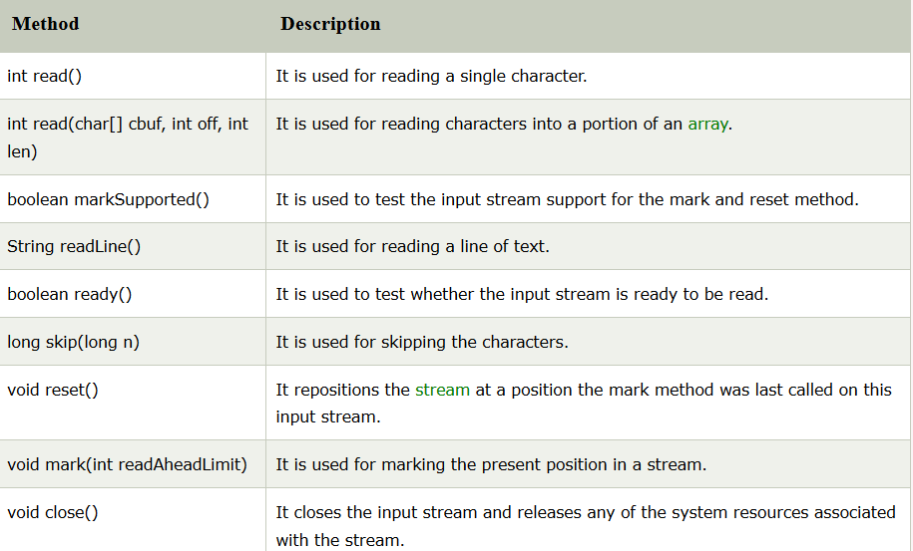
Java BufferedReader Class

Slide 26
import java.io.*;
public class BufferedReaderExample {
public static void main(String args[])throws Exception{
FileReader fr=new FileReader("D:\\testout.txt");
BufferedReader br=new BufferedReader(fr);
int i;
while((i=br.read())!=-1){
System.out.print((char)i);
}
br.close();
fr.close();
}
}
Assuming that you have following data in
"testout.txt" file:
Welcome to javaTpoint.
Output:
Welcome to javaTpoint.

Slide 27
Reading data from console by InputStreamReader and BufferedReader
import java.io.*;
public class BufferedReaderExample{
public static void main(String args[])throws Exception{
InputStreamReader r=new InputStreamReader(System.in);
BufferedReader br=new BufferedReader(r);
System.out.println("Enter your name");
String name=br.readLine();
System.out.println("Welcome "+name);
}
}
Output:
Enter your name Nakul Jain
Welcome Nakul Jain

Slide 28
6. Java CharArrayReader Class
The CharArrayReader is composed of two words:
CharArray and Reader.
The CharArrayReader class is used to read character array as a reader (stream).
It inherits Reader class.

Slide 29
import java.io.CharArrayReader;
public class CharArrayExample{
public static void main(String[] args)
{
char[] ary = { 'j', 'a', 'v', 'a', 't', 'p', 'o', 'i', 'n', 't' };
CharArrayReader reader = new CharArrayReader(ary);
int k = 0;
// Read until the end of a file
while ((k = reader.read()) != -1) {
char ch = (char) k;
System.out.print(ch + " : ");
System.out.println(k);
}
}
}
Output
j : 106
a : 97
v : 118
a : 97
t : 116
p : 112
o : 111
i : 105
n : 110
t : 116

Slide 30
Java CharArrayWriter Class
The CharArrayWriter class can be used to write common data to multiple files.
This class inherits Writer class.
Its buffer automatically grows when data is written in this stream.
Calling the close() method on this object has no effect.

Slide 31
import java.io.CharArrayWriter;
import java.io.FileWriter;
public class CharArrayWriterExample {
public static void main(String args[])throws Exception{
CharArrayWriter out=new CharArrayWriter();
out.write("Welcome to javaTpoint");
FileWriter f1=new FileWriter("D:\\a.txt");
FileWriter f2=new FileWriter("D:\\b.txt");
FileWriter f3=new FileWriter("D:\\c.txt");
FileWriter f4=new FileWriter("D:\\d.txt");
out.writeTo(f1);
out.writeTo(f2);
out.writeTo(f3);
out.writeTo(f4);
f1.close();
f2.close();
f3.close();
f4.close();
System.out.println("Success...");
}
}
Output
Success...
After executing the program, you can see that all files have common data: Welcome to javaTpoint.
a.txt:
Welcome to javaTpoint
b.txt:
Welcome to javaTpoint
c.txt:
Welcome to javaTpoint
d.txt:
Welcome to javaTpoint

Slide 32
Java StringWriter Class
Java StringWriter class is a character stream that collects output from string buffer, which can be used to construct a string. The StringWriter class inherits the Writer class.
In StringWriter class, system resources like network sockets and files are not used, therefore closing the StringWriter is not necessary.

Slide 33
import java.io.*;
public class StringWriterExample {
public static void main(String[] args) throws IOException {
char[] ary = new char[512];
StringWriter writer = new StringWriter();
FileInputStream input = null;
BufferedReader buffer = null;
input = new FileInputStream("D://testout.txt");
buffer = new BufferedReader(new InputStreamReader(input, "UTF-8"));
int x;
while ((x = buffer.read(ary)) != -1) {
writer.write(ary, 0, x);
}
System.out.println(writer.toString());
writer.close();
buffer.close();
}
}
testout.txt:
Javatpoint provides tutorial in Java, Spring, Hibernate, Android, PHP etc.
Output:
Javatpoint provides tutorial in Java, Spring, Hibernate, Android, PHP etc.

Slide 34
Java Console Class
The Java Console class is be used to get input from console. It provides methods to read texts and passwords.
If you read password using Console class, it will not be displayed to the user.
The java.io.Console class is attached with system console internally.

Slide 35
Java Console Example
import java.io.Console;
class ReadStringTest{
public static void main(String args[]){
Console c=System.console();
System.out.println("Enter your name: ");
String n=c.readLine();
System.out.println("Welcome "+n);
}
}
Enter your name: Nakul Jain Welcome Nakul Jain

Slide 36
Java Console Example to read password
import java.io.Console;
class ReadPasswordTest{
public static void main(String args[]){
Console c=System.console();
System.out.println("Enter password: ");
char[] ch=c.readPassword();
String pass=String.valueOf(ch);//converting char array into string
System.out.println("Password is: "+pass);
}
}
OUTPUT:
Enter password:
Password is: 123

